Slide 1
COVID-19 Tracking Germany
https://www.kaggle.com/datasets/headsortails/covid19-tracking-germany
https://github.com/doctorf72/Naya-Practical-Data-Science-EDA-Project

Slide 2
Background
Coronavirus disease (COVID-19) is an infectious disease caused by the SARS-CoV-2 virus.
The first known case was identified in China Wuhan at December 2019.
The disease quickly spread worldwide, resulting in the COVID-19 pandemic.
This dataset provides daily updated number of reported cases & deaths in Germany on state and county level from January 2020.
A dataset on vaccination progress from December 2020.
And a general state-level population demographics.

Slide 3
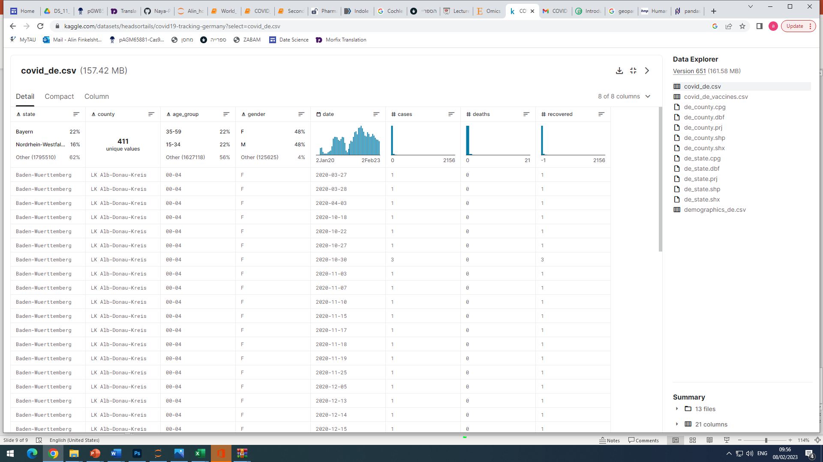
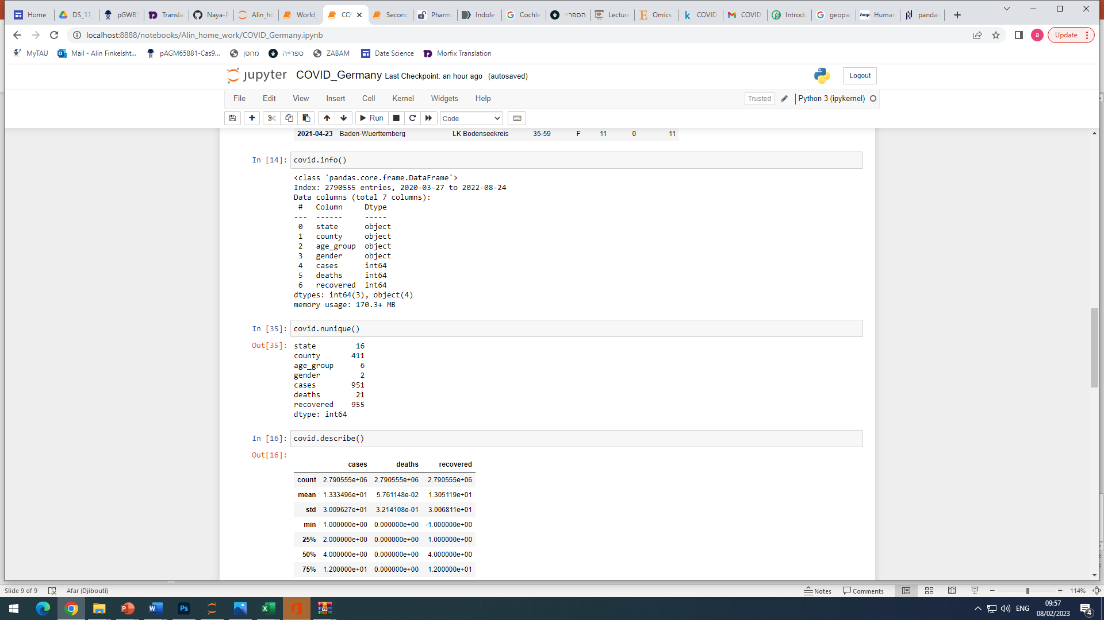
Dataset contains 3 tables:
covid_de.csv
Nunique
…………….

Slide 4
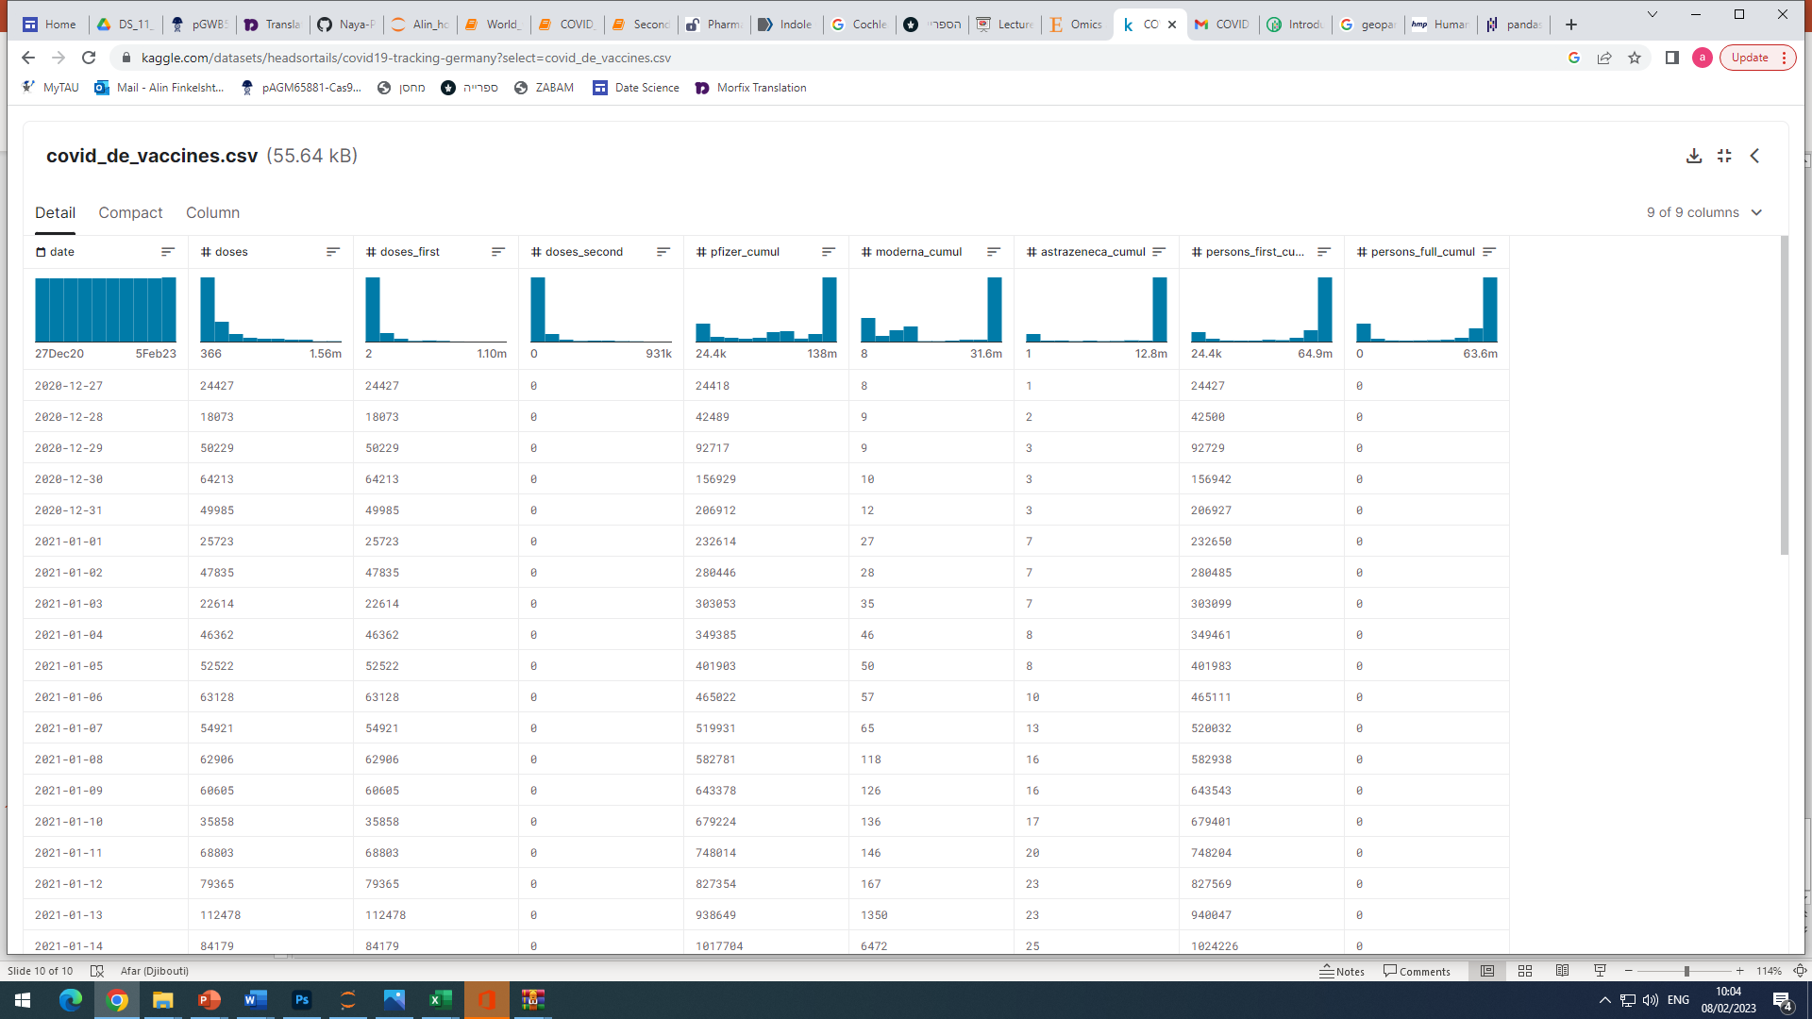
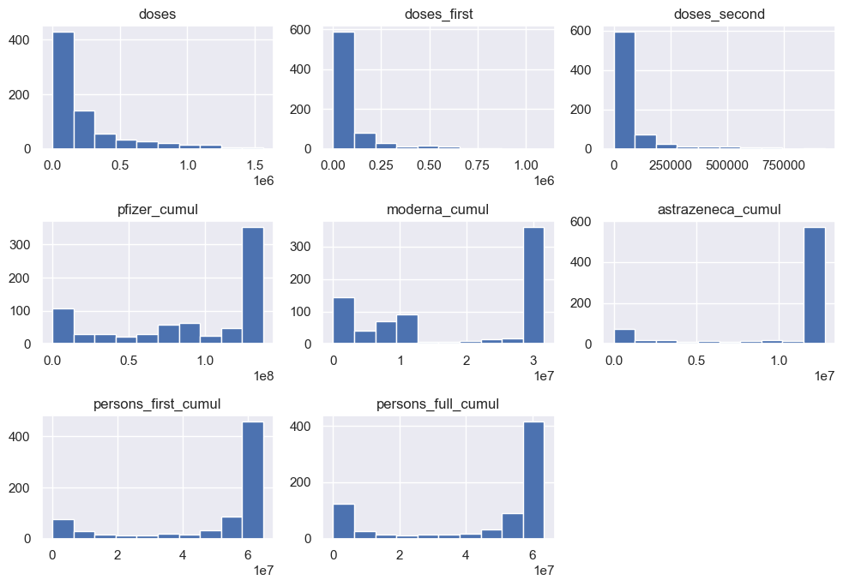
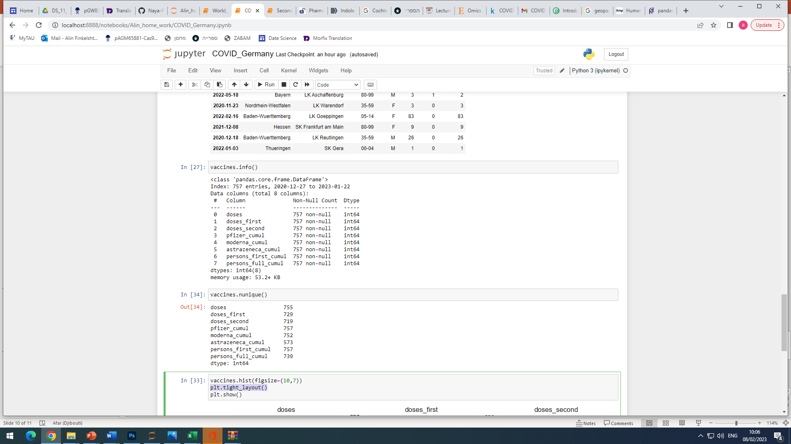
covid_de_vaccines.csv
Nunique
…………….

Slide 5
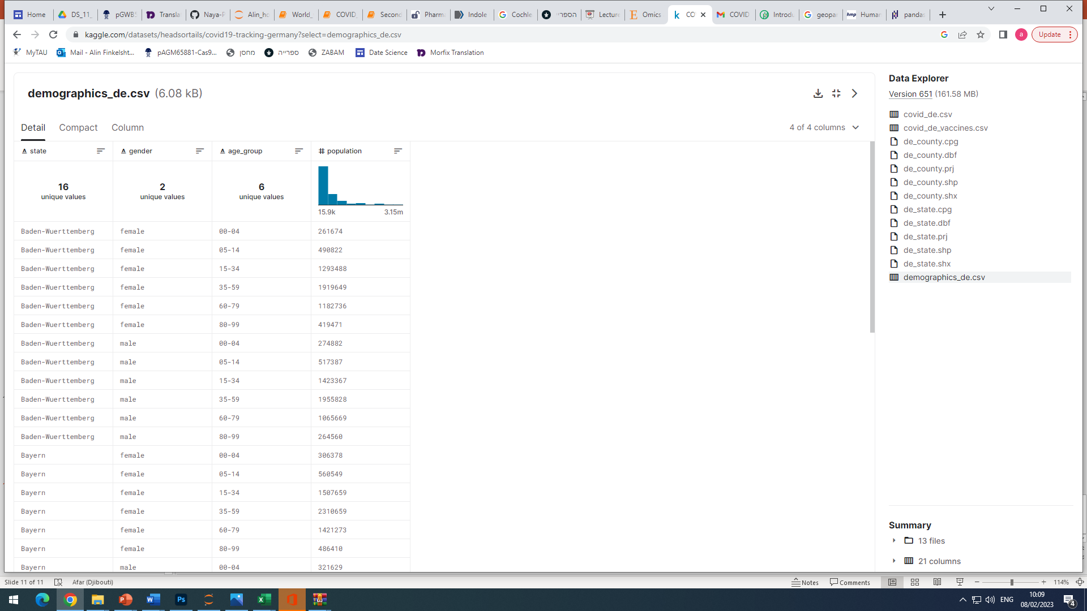
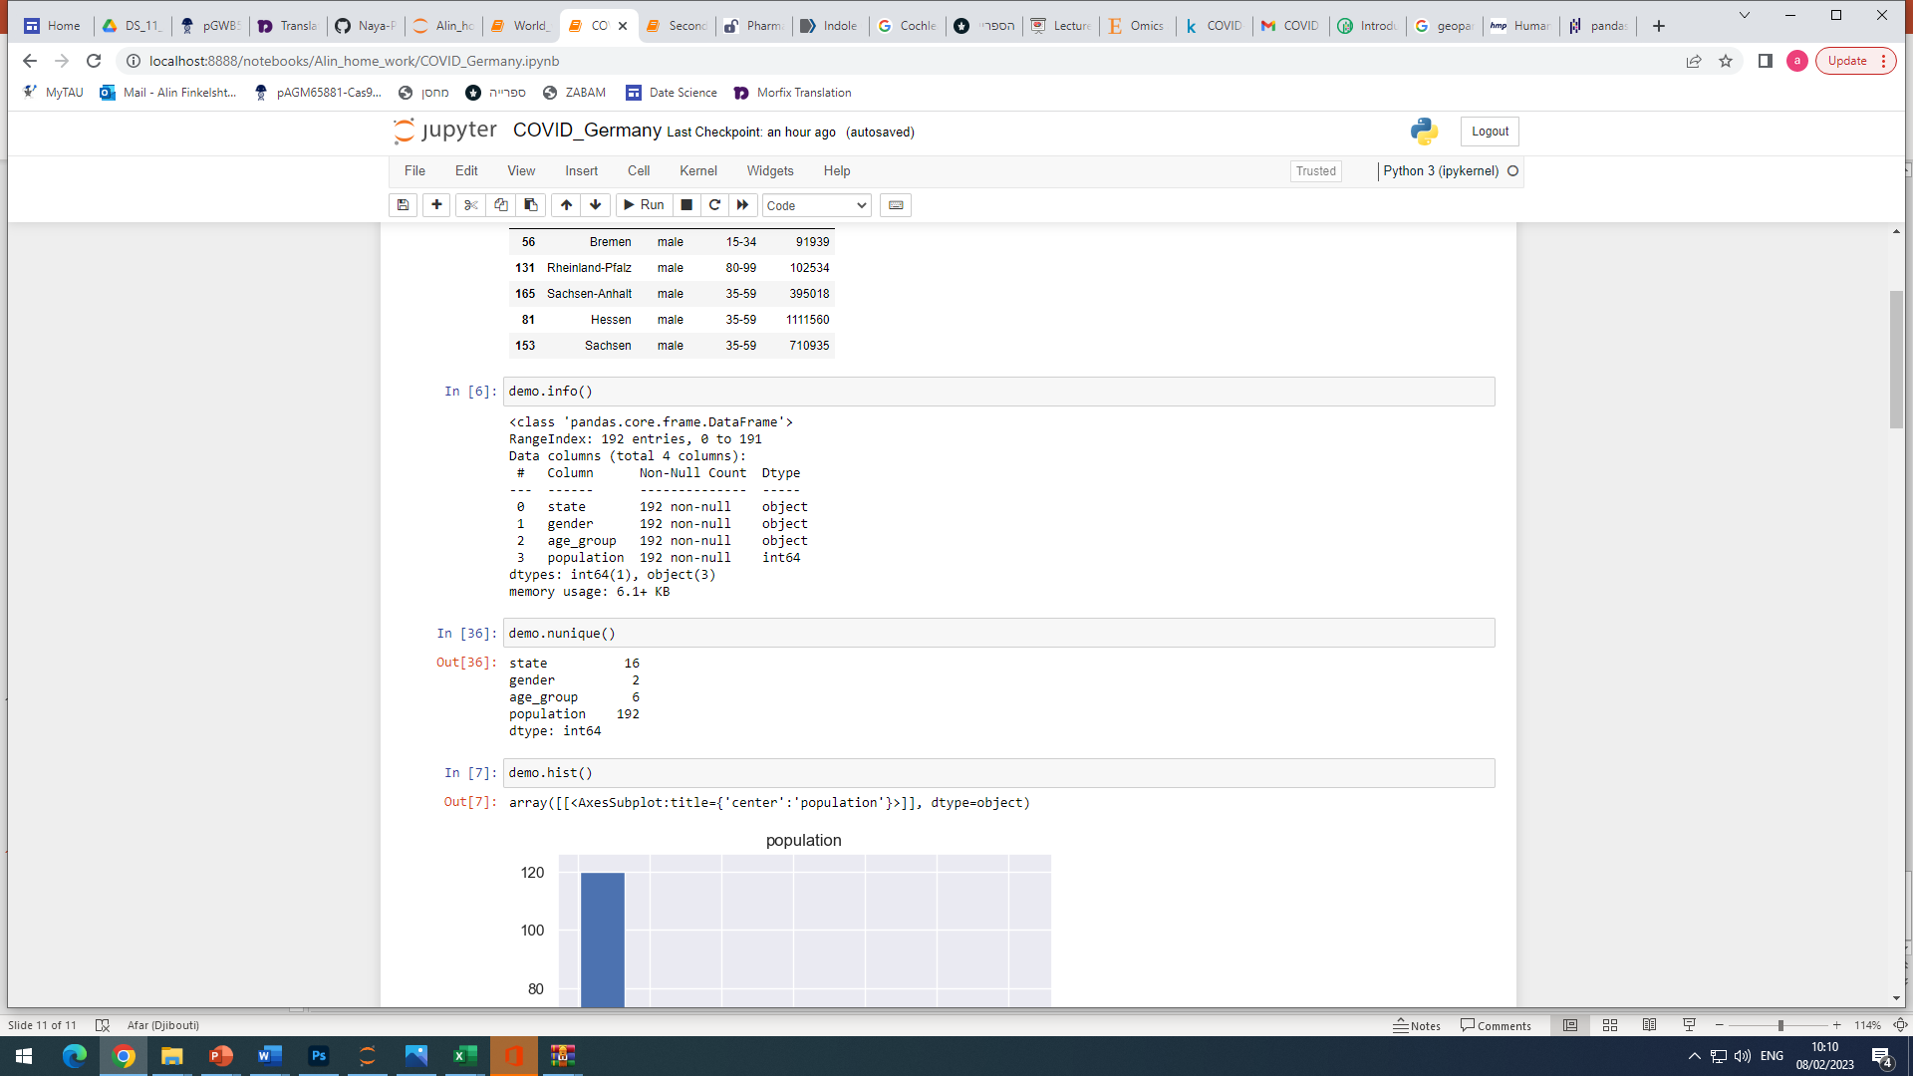
demographics_de.csv
Nunique
…………….

Slide 6
Data analysis

Slide 7
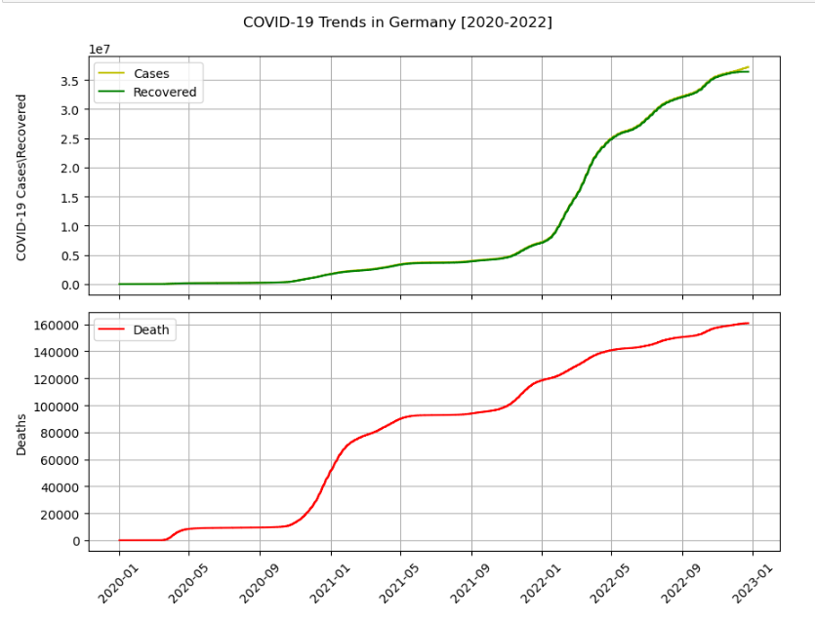
Time trends for cumulative cases, recoveries and deaths
Based on data set we are looking into cumulative counts of cases, recovered cases and deaths in Germany during 2020 – 2022.
Observation that recovery counts correlate with overall cases.
Few periods observed in deaths trends that should be understood.

Slide 8
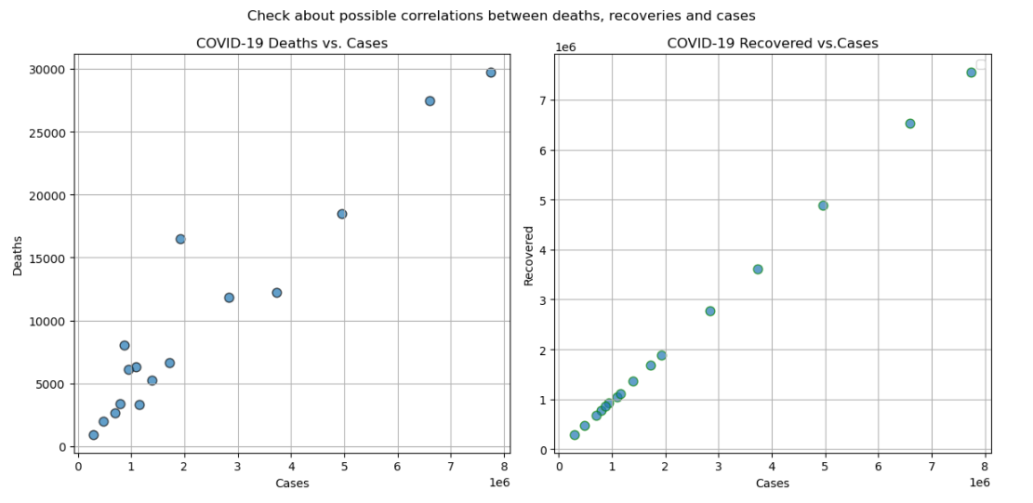
Correlations
Observed correlation between cases and number of deaths and recoveries

Slide 9
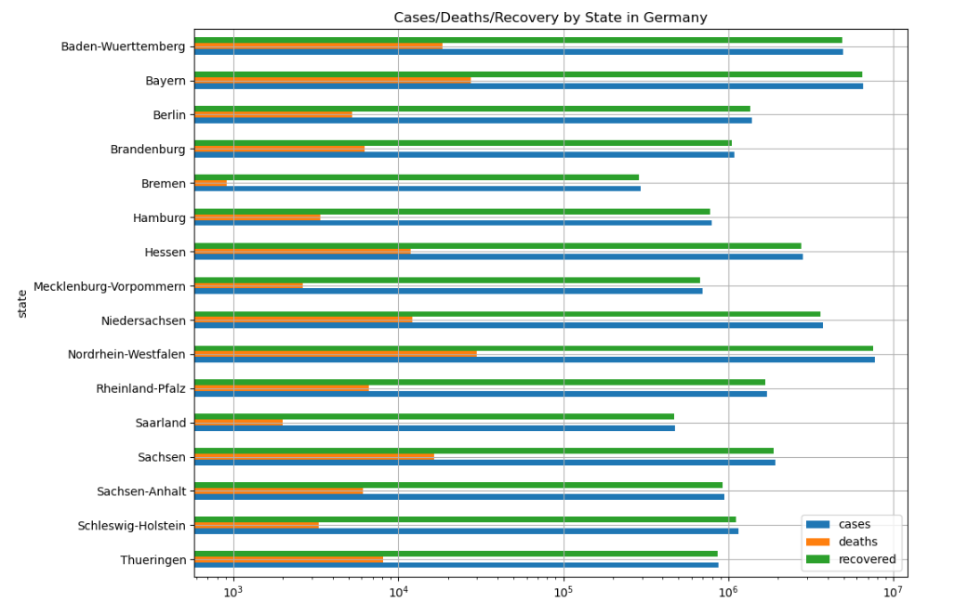
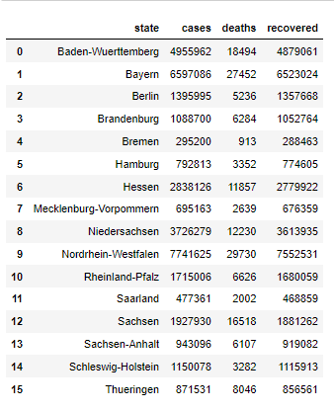
Cases/Death/Recoveries by German States

Slide 10
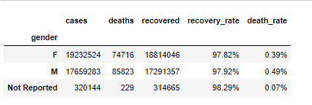
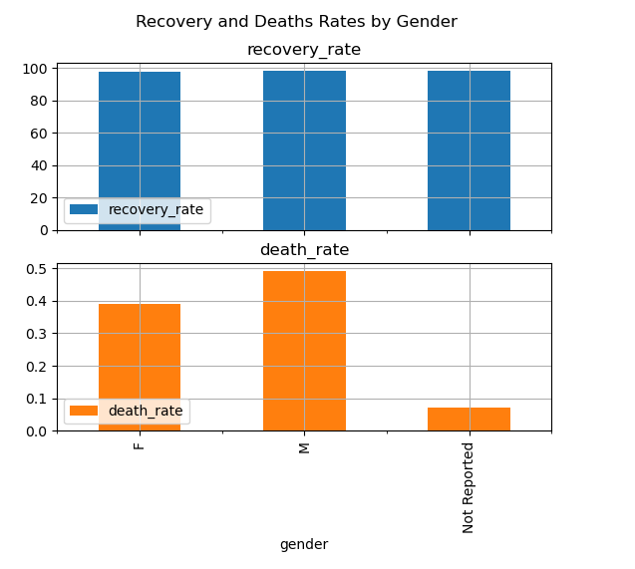
COVID 19 cases, recovery and death rates by gender
No significant difference observed

Slide 11
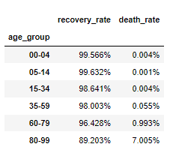
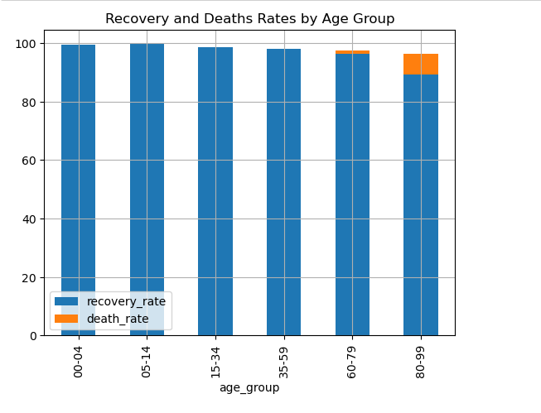
COVID 19 cases, recovery and death rates by age group
In age groups observed trend of recovery and deaths rates based on age groups

Slide 12
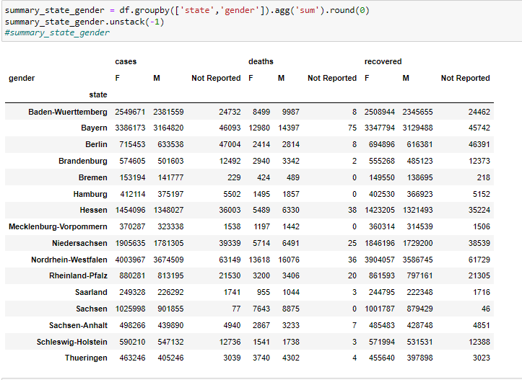
Summary by state and gender combined

Slide 13
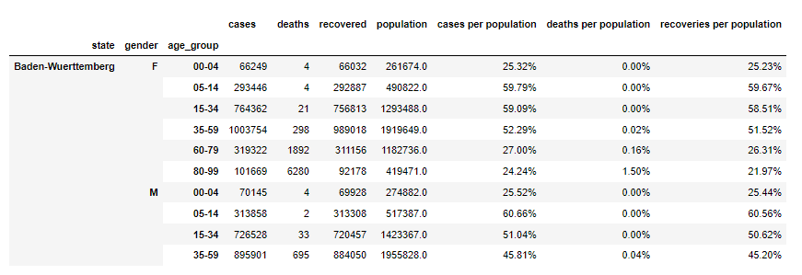
Summary by state, gender and age combined

Slide 14
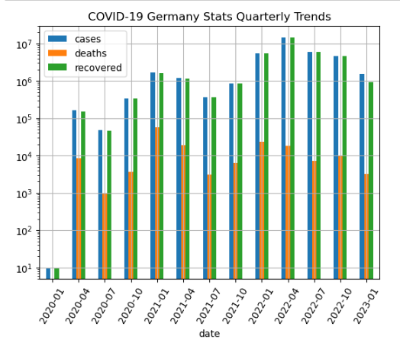
Quarterly COVID 19 trends

Slide 15
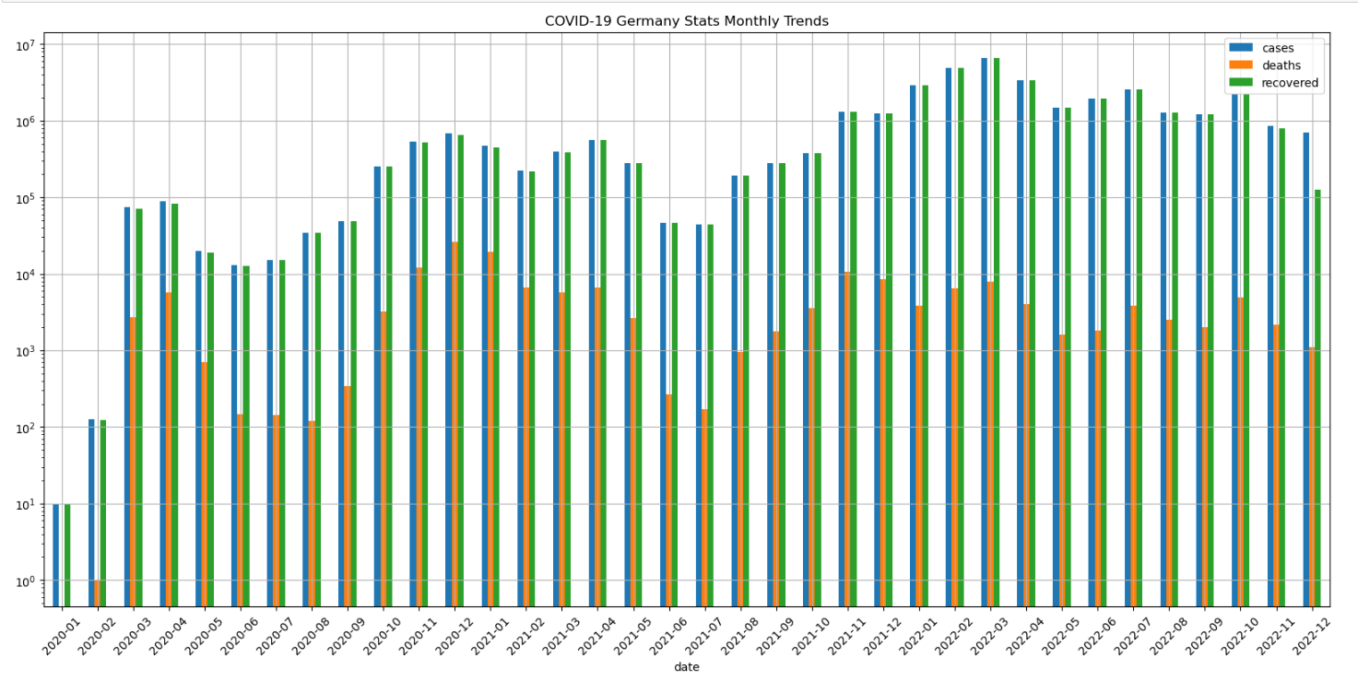
Monthly COVID 19 trends

Slide 16
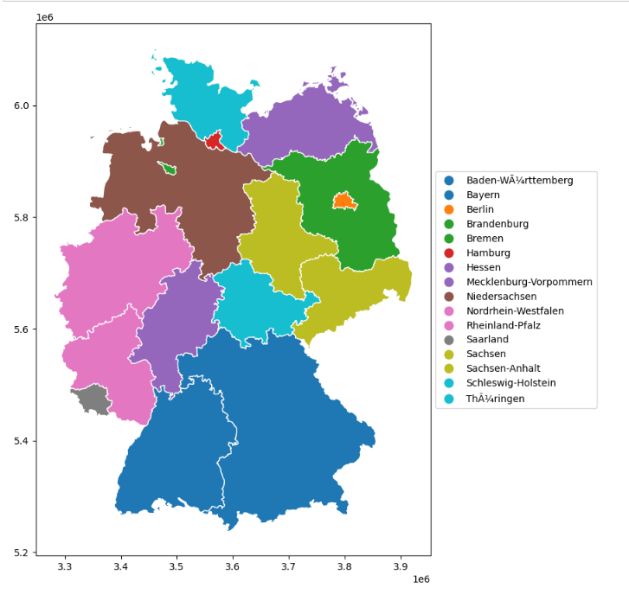
Data illustration using Geopandas package
We are learned to utilize Geopandas package to represent data

Slide 17
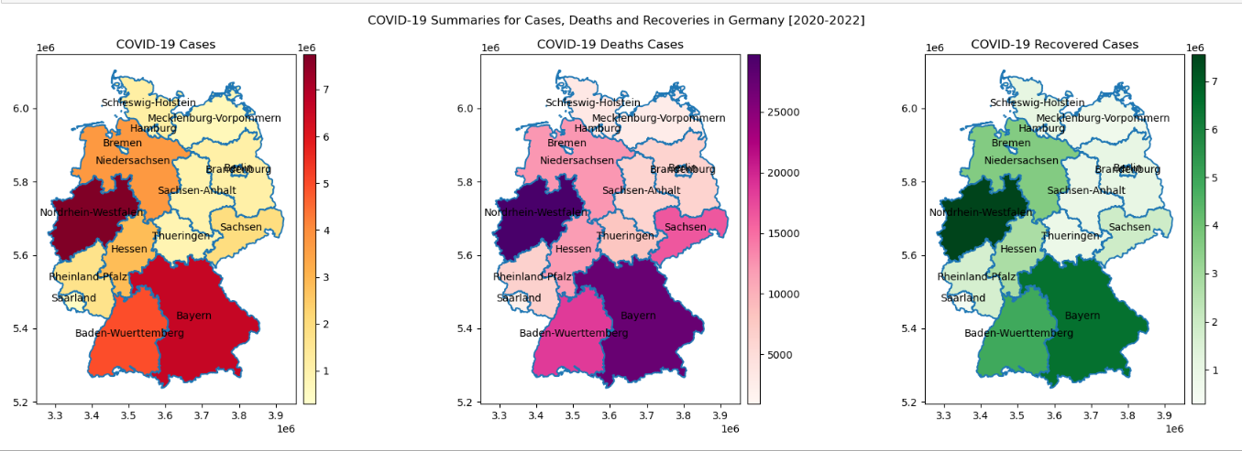
COVID 19 Cases, Deaths and Recoveries for Germany 2020-2022
3 states are extremely high for cases, deaths counts:
Nordrhein-Westfalen
Baden-Wuerttemberg
Bayern

Slide 18
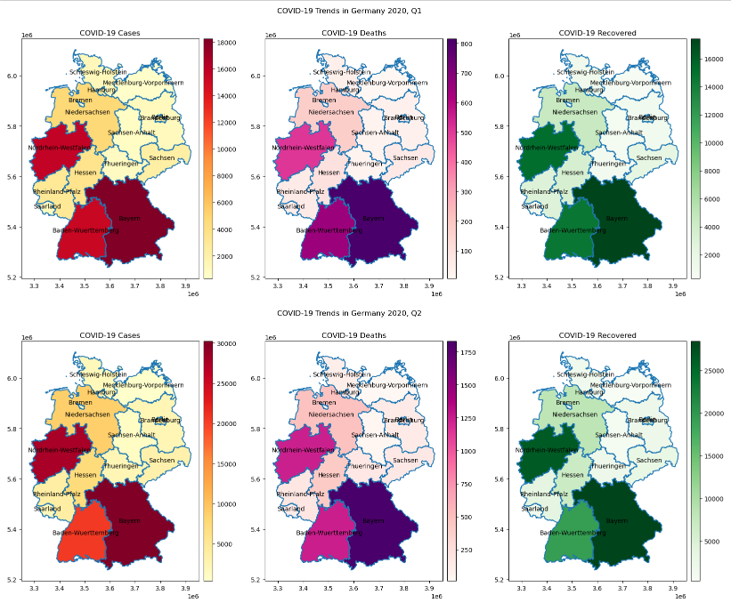
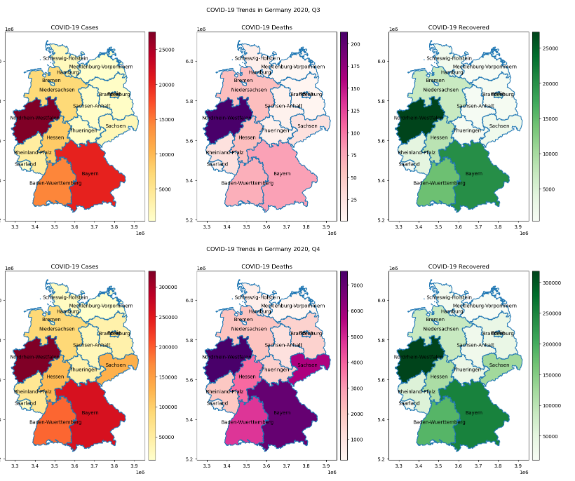
2020 Quarterly Trends
Q1
Q3
Q2
Q4

Slide 19
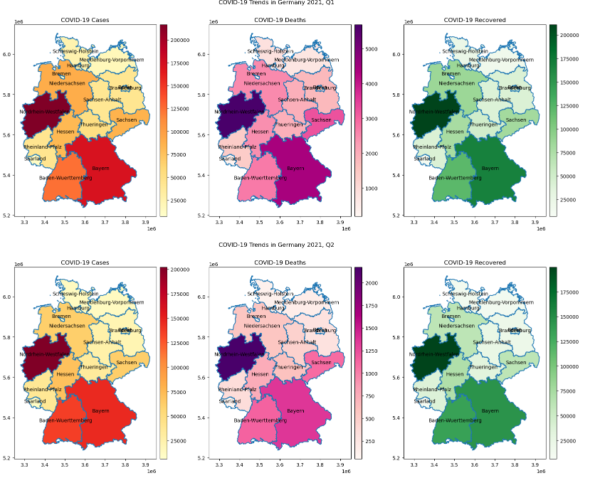
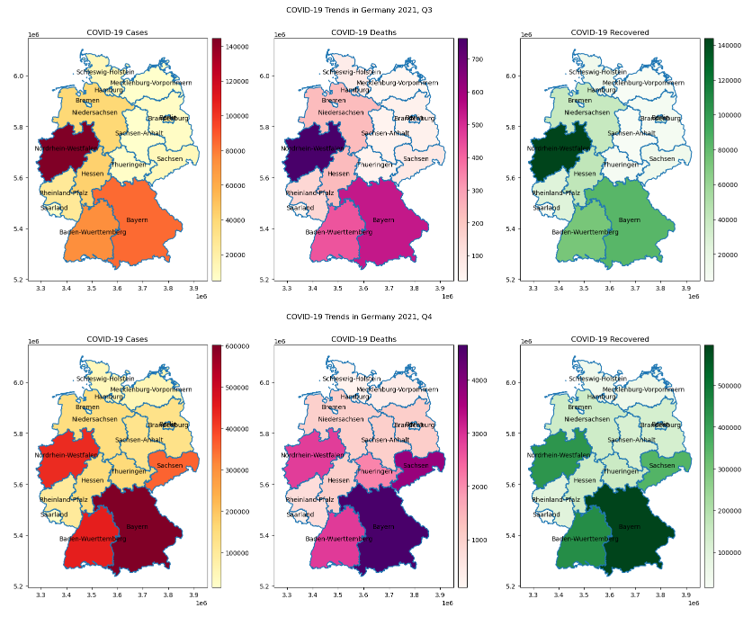
2021 Quarterly Trends
Q1
Q3
Q2
Q4

Slide 20
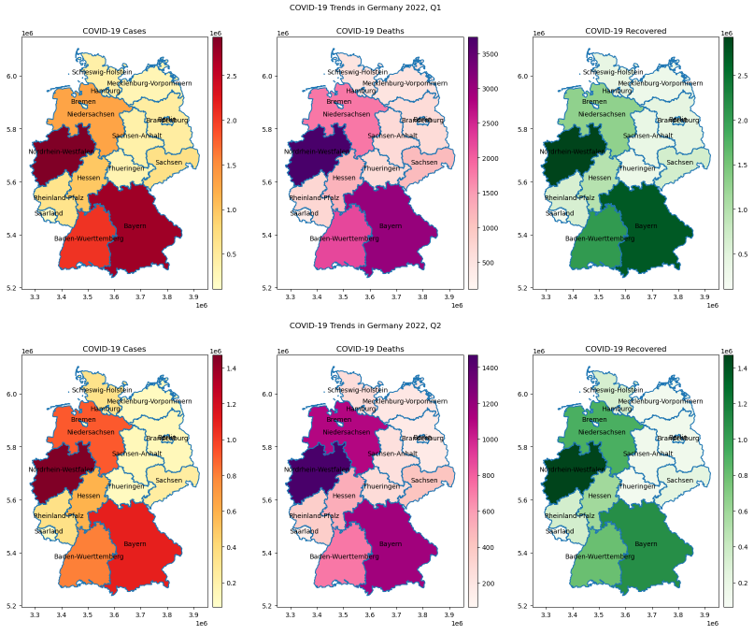
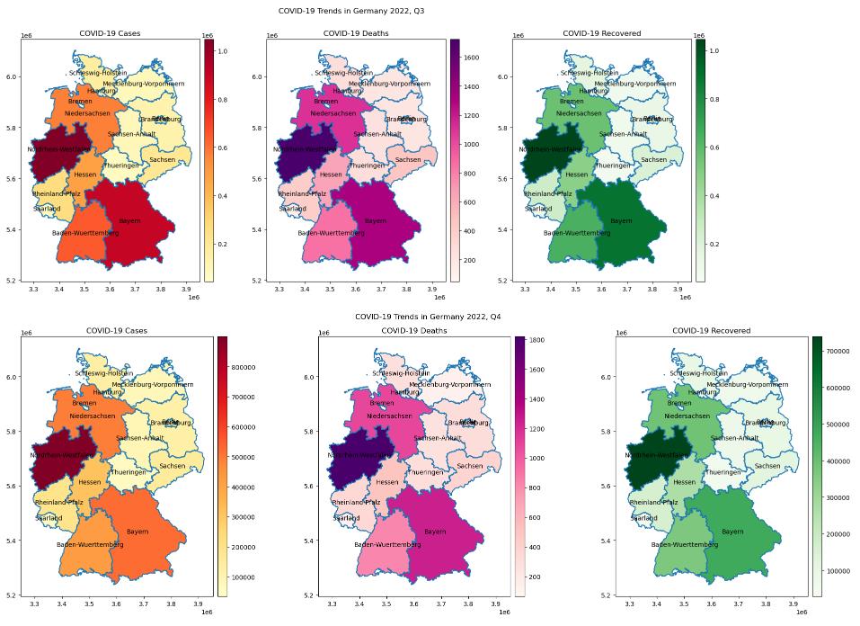
2022 Quarterly Trends
Q1
Q3
Q2
Q4

Slide 21
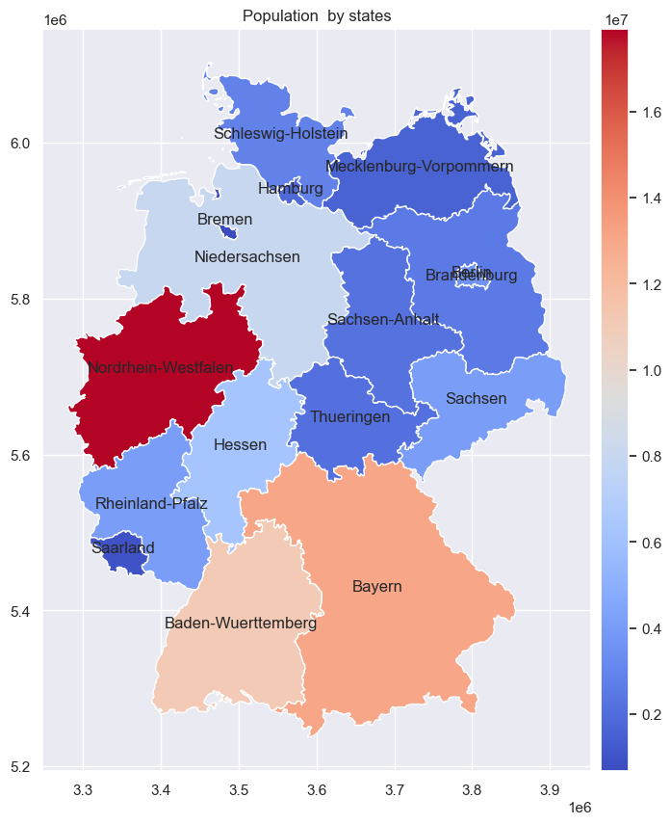
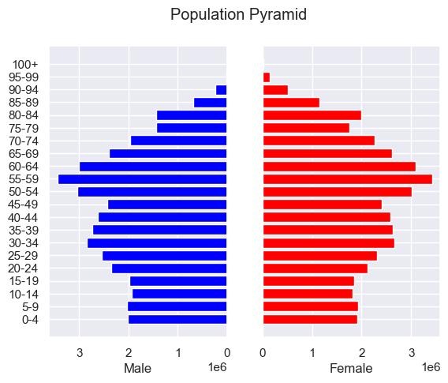
Population in Germany
Total population = 83,019213
Germany is divided to 16 states

Slide 22
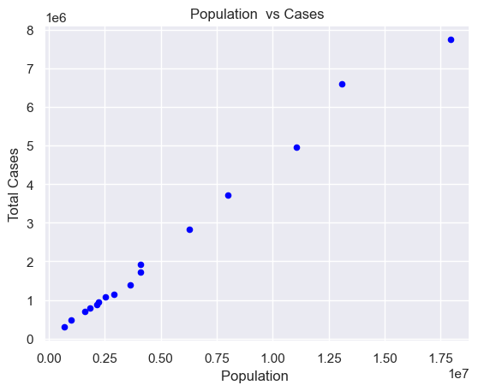
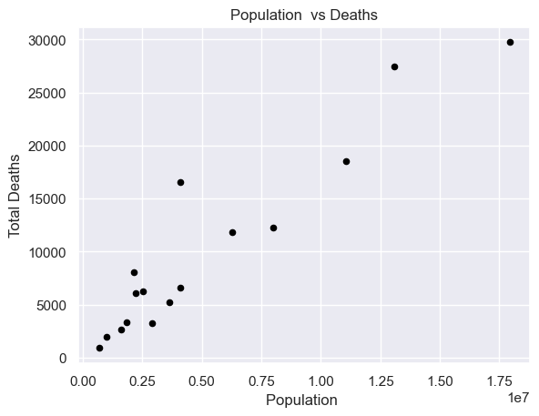
There is clear correlation between population and number of cases/deaths

Slide 23
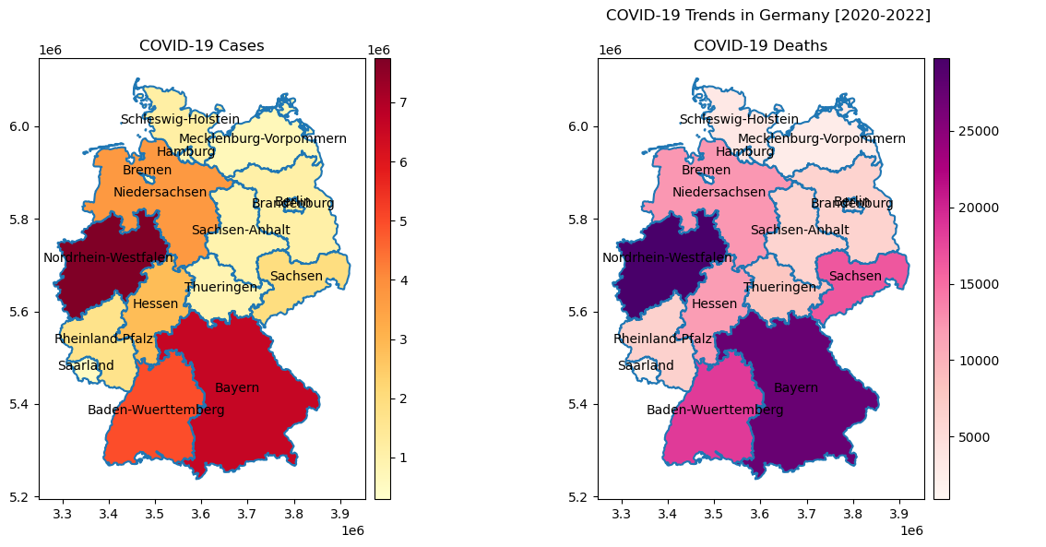
There is clear correlation between population density and number of cases/deaths

Slide 24
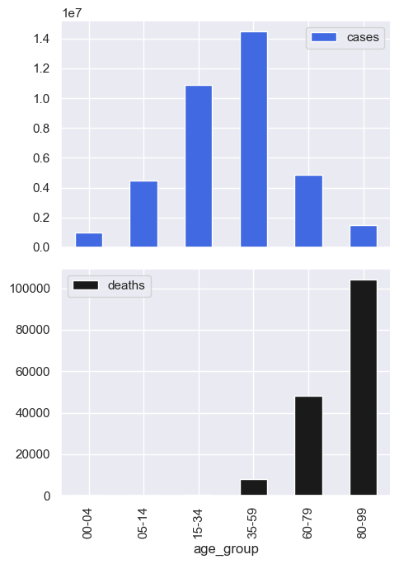
Are certain age groups more susceptible to infection and /or death?
Infection
Young children (>14) and old people (60+) are less susceptible for covid infection.
Alternatively are asymptomatic and are not revealed (Children)
Have a problem to do the test and are not revealed (Aged)
Were isolated and thus were less infected
Young adults and mature population are infected more.
Death
The older you are the higher are your chances to die from COVID19.

Slide 25
There are 3 states with most population, cases and deaths. Lets test them by counties

Slide 26
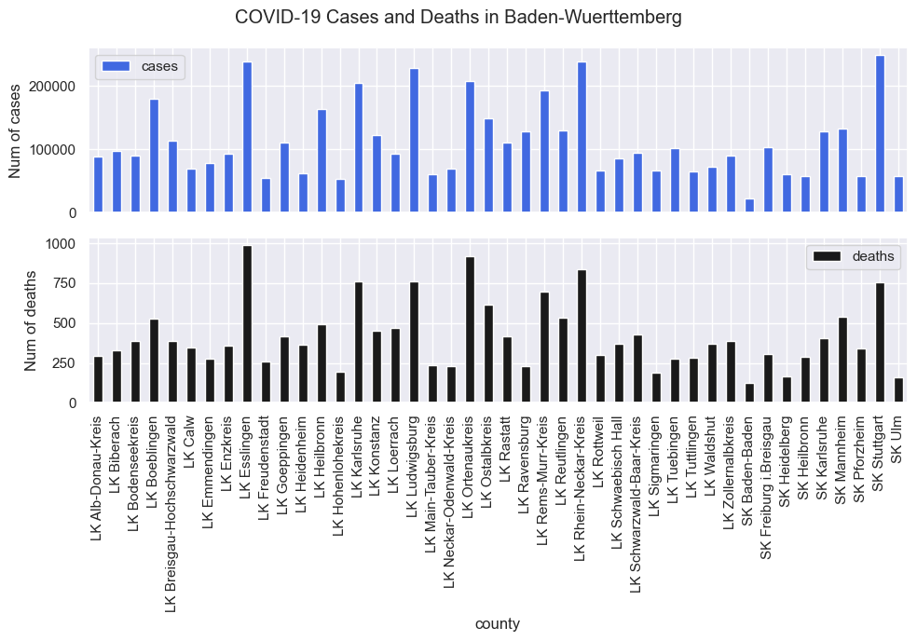
Baden-Wuerttemberg

Slide 27
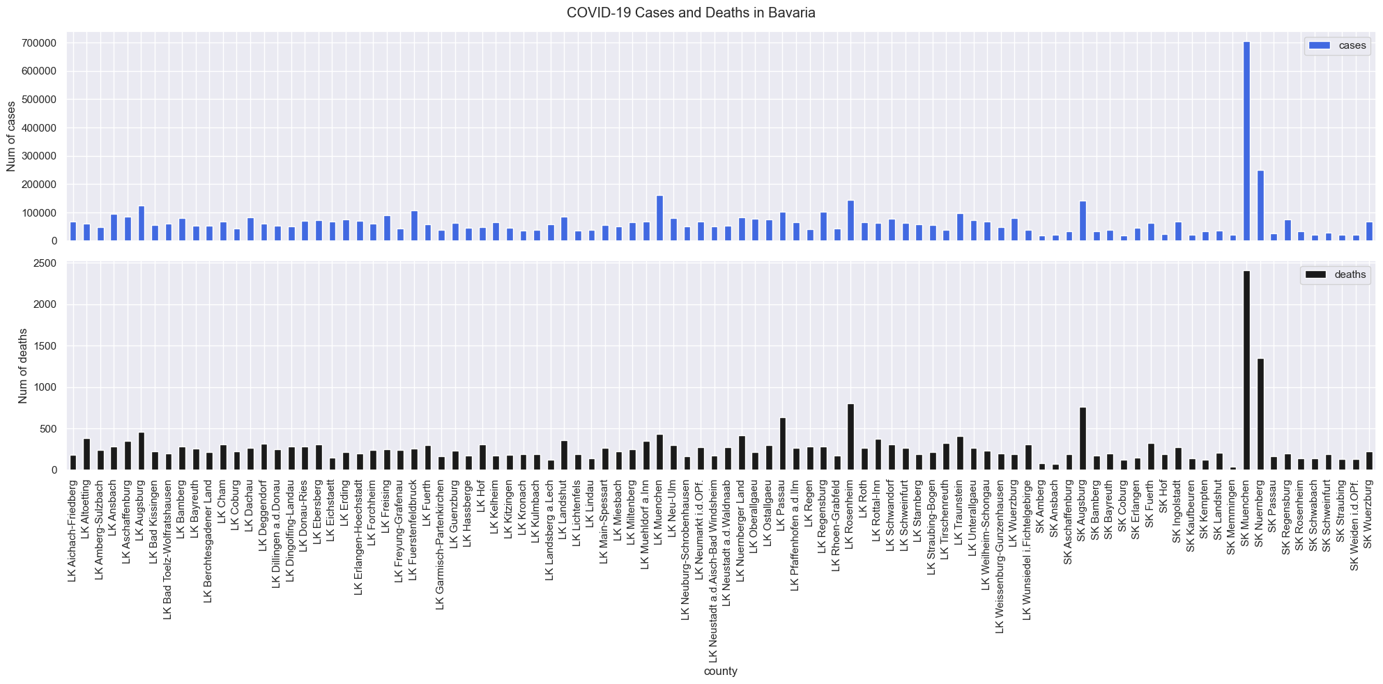
Bavaria

Slide 28
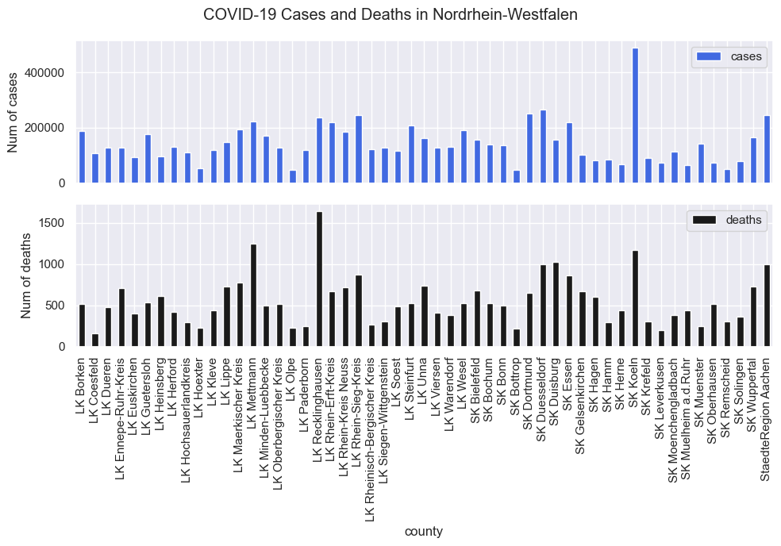
Nordrhein-Westfalen

Slide 29
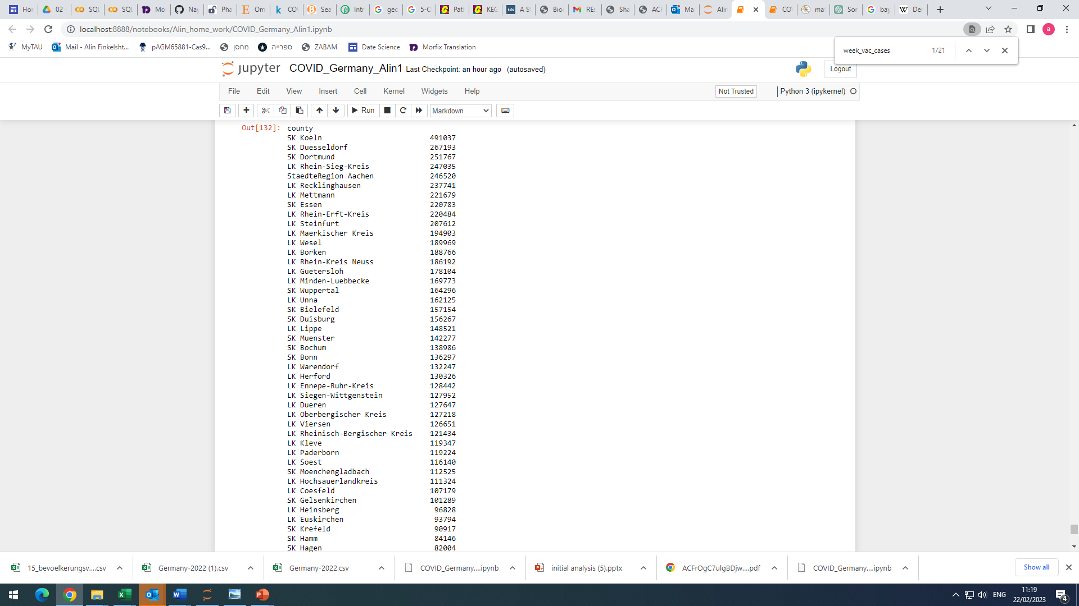
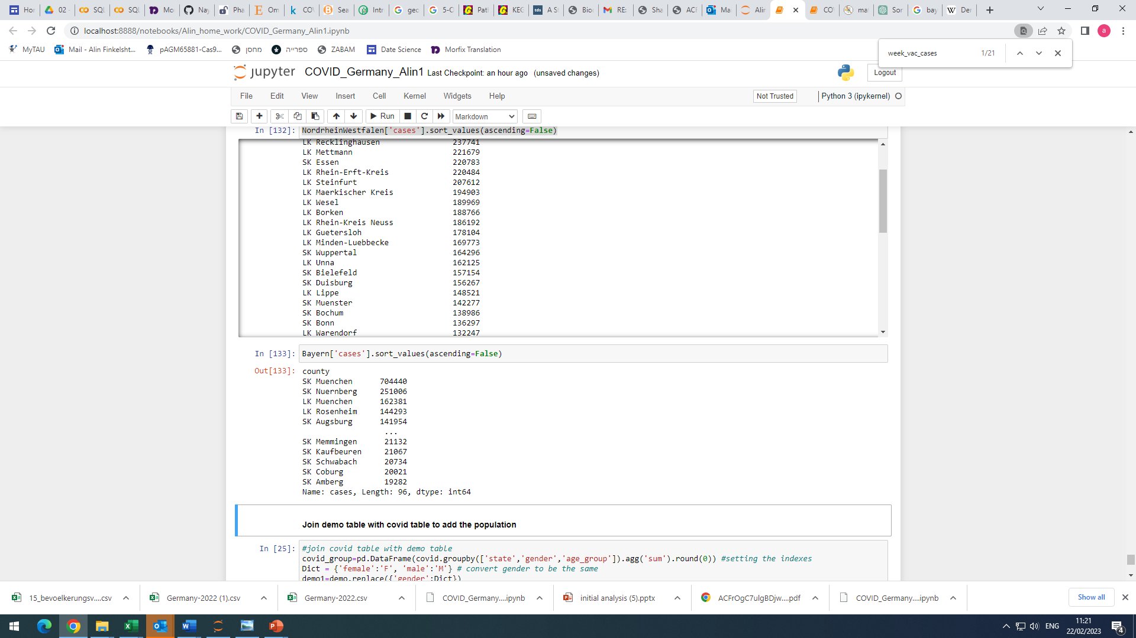
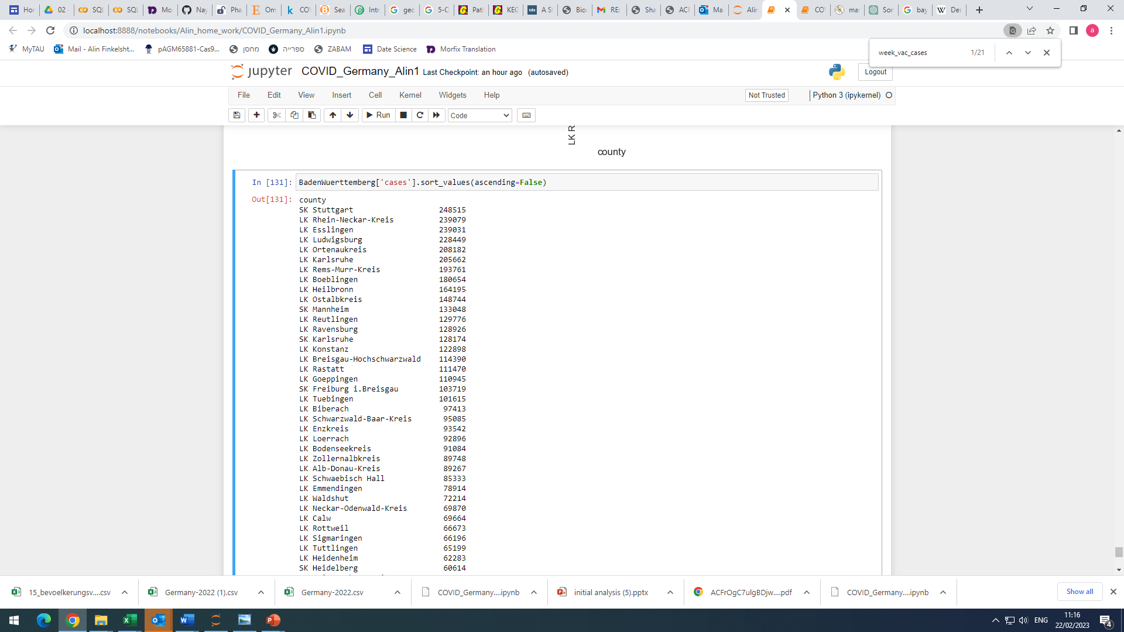
We can see that most cases are concentrated in the big cities :
Nordrhein-Westfalen
Bavaria
Baden-Wuerttemberg

Slide 30
Vaccination analysis in Germany

Slide 31
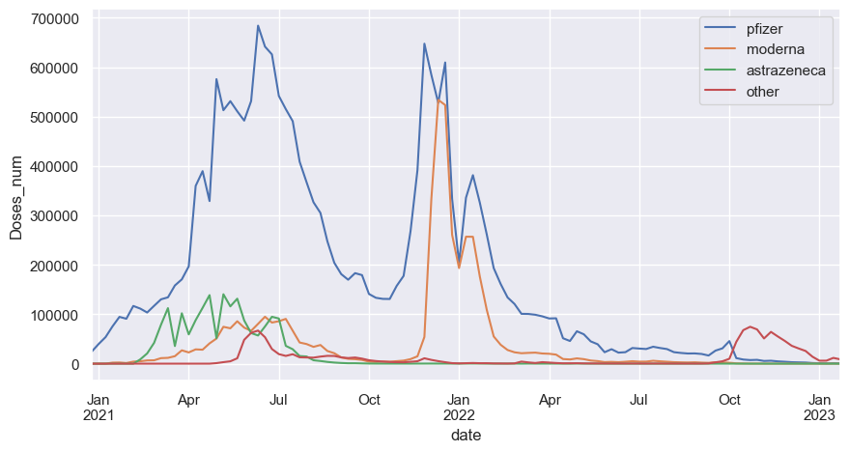
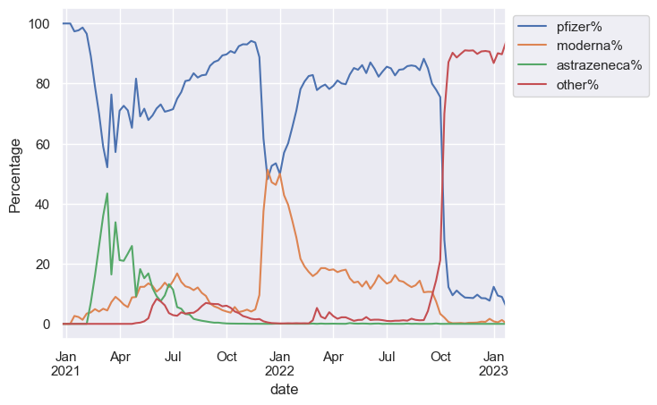
What is the contribution of each manufacturer?
There are 3 main manufacturers in Germany: Pfizer, moderna and astrazeneca.
The most commonly used is Pfizer
In Jan 22 it was a reduction in pfizer use that was replaced by moderna.
Astrazeneca was mainly used in the beginning: Feb-Jul 21 and abandoned afterwards.
Other manufacturers are used from Oct 2022

Slide 32
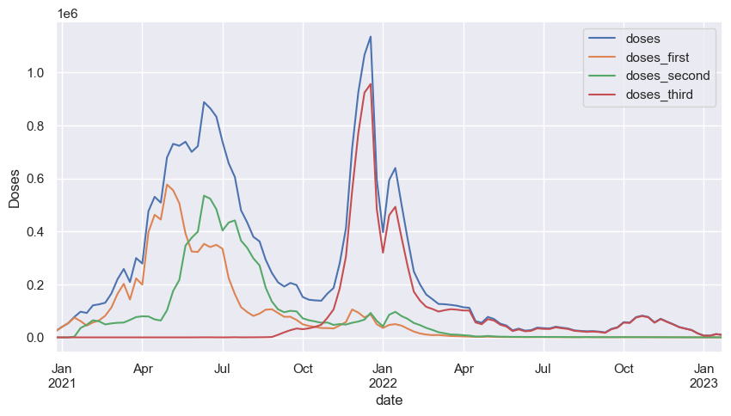
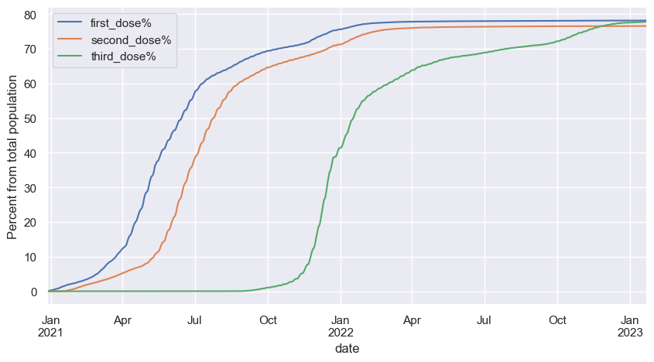
Vaccination patterns
With the appearance of the vaccines most of the population (~60%) got first and second dose.
Starting from Nov 2022 again most of the population (~60%) got the third dose.
Remaining population show a decrease ratios of vaccination, however, 78% are vaccinated with 3 doses today in Germany.
Conclusion – most population is very disciplined and obeys the government guidance.

Slide 33

Was the vaccination necessary?

Slide 34
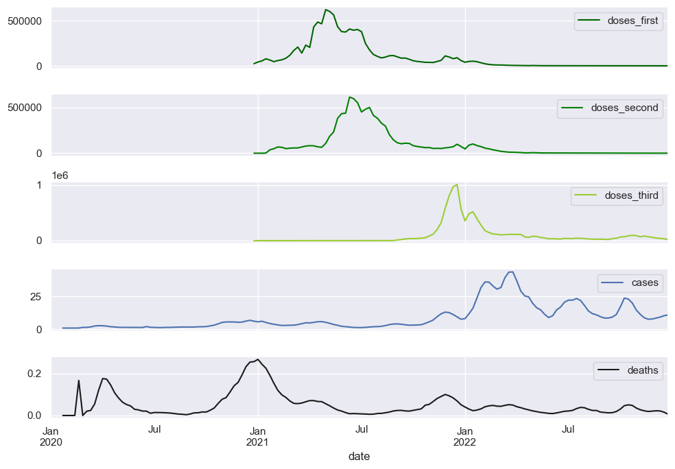
The effect of vaccination on number of cases and deaths
There is no effect on number of cases ) chance to get infected), but the number of deaths decreased following the vaccination.
The death ratio before the beginning of vaccinated was 2.8% following 3 doses of vaccination it decreased to 0.16%!
2.8%
0.16%

Slide 35
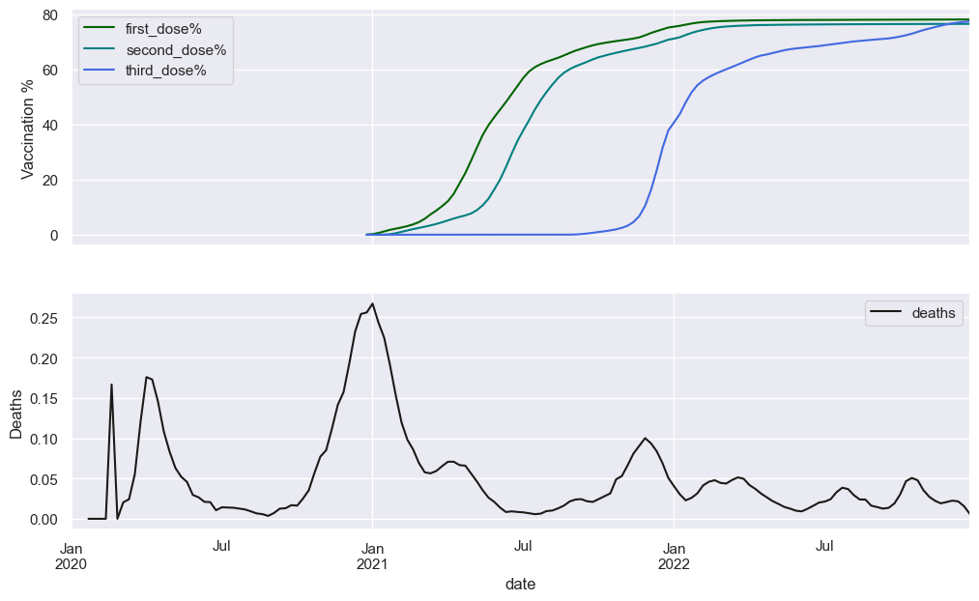
After first dose of vaccination the death rate decreased from 2.5% to 0.21%
2.5%
0.21%
60% vaccination

Slide 36
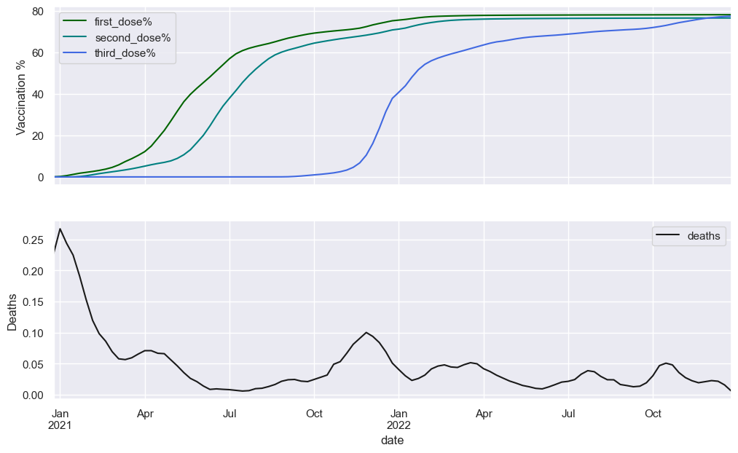
Death rate from the beginning of vaccination
0.6%
0.16%
60% vaccination

Slide 37
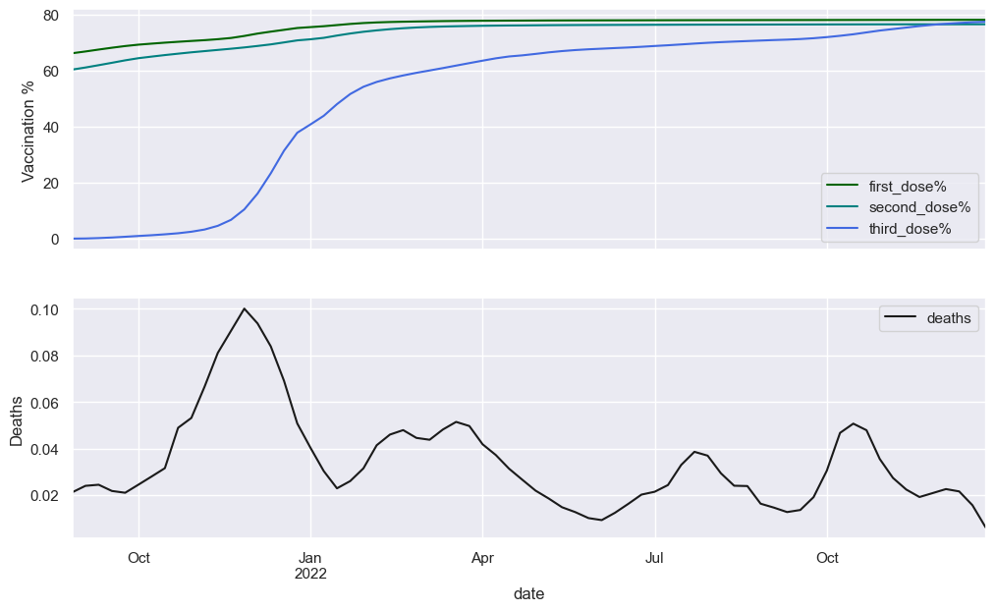
The 3rd dose of vaccination had beneficial effect on death rates even after two doses.
0.3%
0.16%
60% vaccination

Slide 38
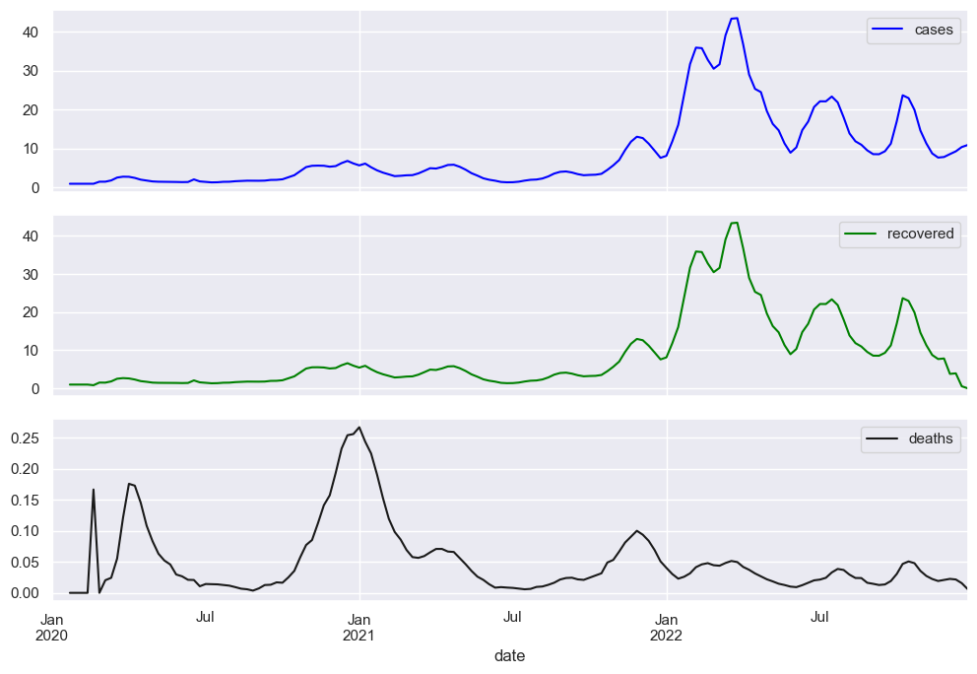
Alternative explanation could be natural immunization due to recovery.
1.9%
Recovery ratio
4.38%
18.6%
Beginning of vaccination
60% got the 1st dose
60% got the 3rd dose

Slide 39
Alternative explanation could be natural immunization due to recovery.
The ratio of recovery/natural immunization is too low to be responsible for decrease in death rates.

Slide 40
Was the vaccination necessary?
Defiantly YES!

Slide 41
The main questions we can ask
Are there differences between genders in getting sick, recovery ratio, death ratio - Felix
Vaccination trends – any conclusions – Alin done
Are there differences in different age groups ( same parameters as above) – Felix /Alin with pivot table and conclusions
Geopandas
Can we see differences in different regions of the country in the above parameters – Felix
6 graphs with cases/recovery numbers per state on maps (resample every 6 month) - Alin
% of population fully vaccinated/partially vaccinated/not vaccinated in each region/county Alin
Are regions with younger population tend to vaccinate more /less vs older population regions? Alin
Can we see a decrease in death following vaccination? – Alin - done

